Slide 1

Records Management: the API story
David Webster, Staff Software Engineer, Alfresco

Slide 2

Next 30 mins:
Intro (me, team, product)
Records Management -> Governance Services
API overview
Demo

Slide 3

Intro

Slide 4

David Webster
Alfresco Engineer since 2010
A lead engineer in GS team
Working on RM
Previously on Share & other UI stuff
Order of the Bee member
Alfresco community fan
Father/husband
Search and Rescue volunteer

Slide 5
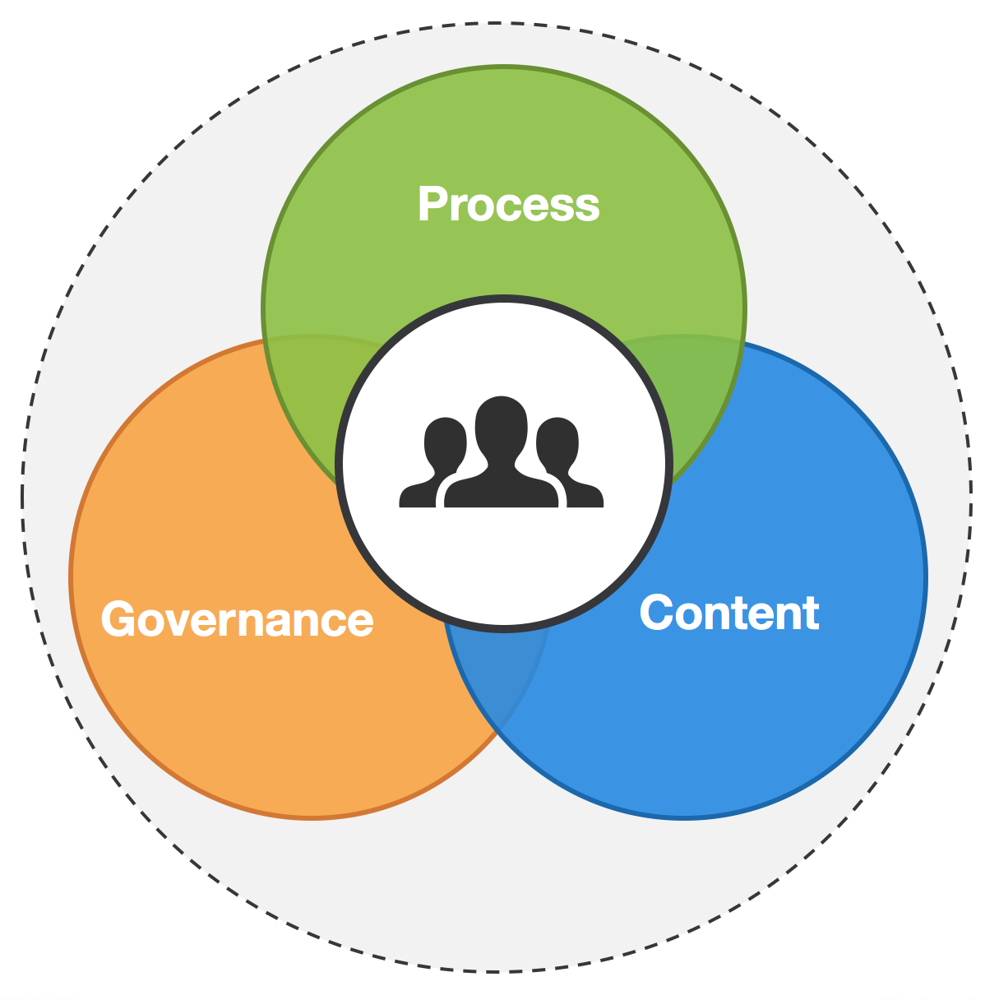
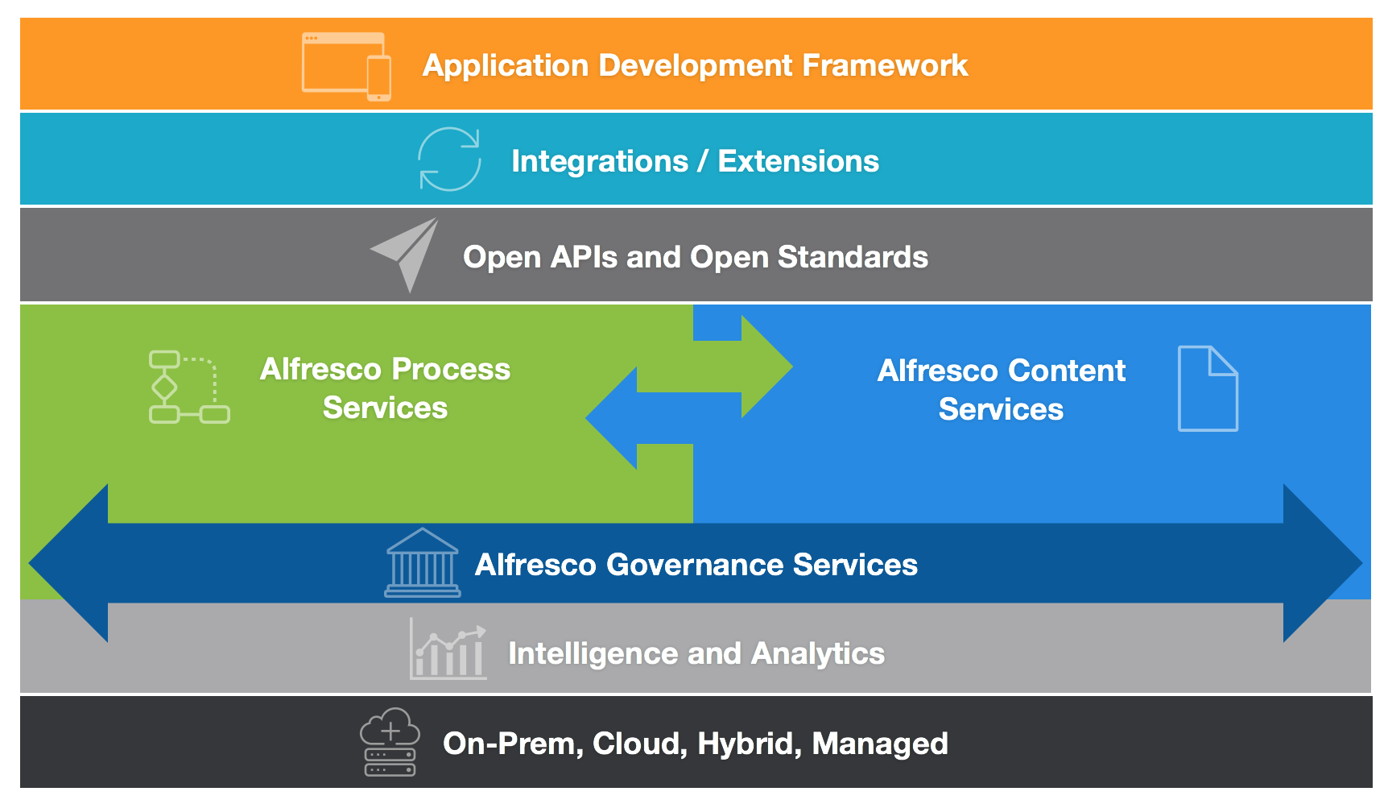
Governance Services vs Records Management

Slide 6
Why Governance Services?
Governance includes more than just management of records
Governance applies to all content, including that outside of RM site
RM module is currently how we ship our governance capabilities, but that might change.

Slide 7
12 months in review:
21 Releases (2 major Enterprise, 3 Community, 3 Service packs, 13 Hot fixes)
Team grown to 18 (11 Maidenhead, 6 Romania, 1 Sydney)
Over 2100 JIRAs worked on.
Re-established GitHub mirror
Travis-CI builds
First community PR
When | What
April 2016 | V2.4.b, V2.4
May 2016 | V2.3.0.4, V2.3.0.5
June 2016 | V2.5-EA1
August 2016 | V2.3.0.6, V2.5-EA2, V2.4.0.1 V2.5
September 2016 | V2.3.0.7, V2.5.a, V2.2.0.1
October 2016 | V2.3.0.8, V2.2.0.2
November 2016 | V2.5.0.1, V2.3.1
January 2017 | V2.3.0.9
February 2017 | V2.5.1, V2.4.0.2
March 2017 | V2.2.0.3
April 2017 | V2.3.1.1, V2.4.1, V2.5.b

Slide 8
Especially for BeeCon:
2.5.b released yesterday afternoon
(5.2 compatibility)

Slide 9
GS API

Slide 10
GS v1 REST APIs
APIs as a feature
Debuts in RM 2.6
Existing extension points and old REST (v0) APIs and Java APIs are still there.
You should use v1 REST APIs in preference.
API first development
Match v1 APIs from elsewhere in Digital Business Platform.

Slide 11
Scope of the APIs
Complete File Plan CRUD
Filing records
Declaring content as records
Update record metadata

Slide 12
Explore APIs
API Explorer: http://localhost:8080/gs-api-explorer/
Postman: https://github.com/Alfresco/gs-api-postman-collection

Slide 13
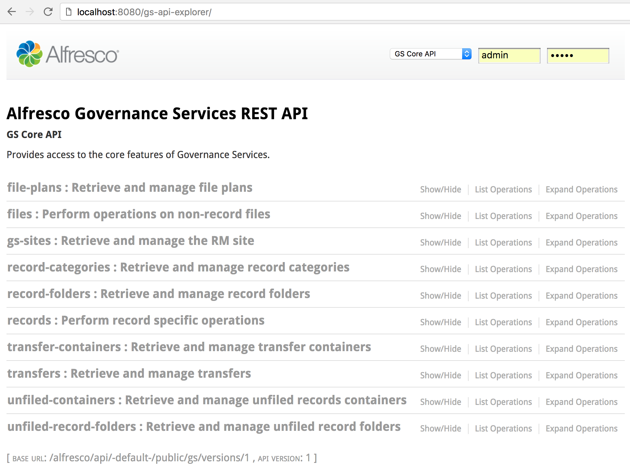
API Explorer

Slide 14
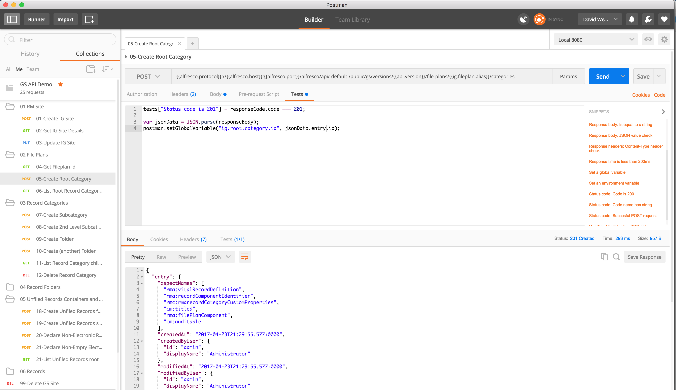
Postman

Slide 15
Demo

Slide 16


Slide 17
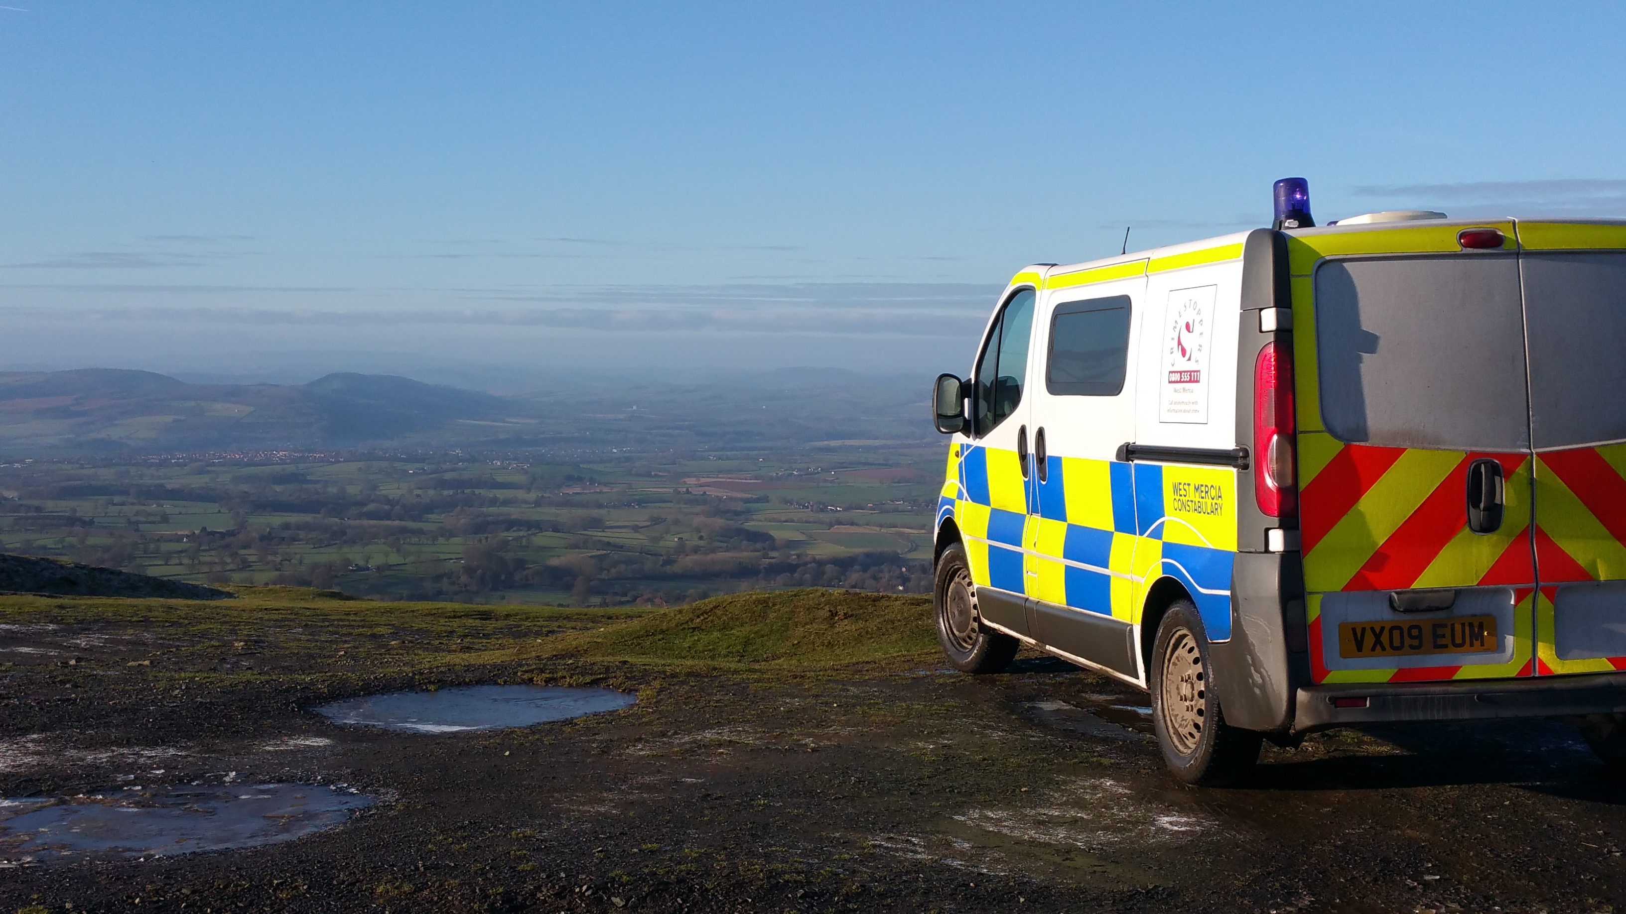
Photo of initial call

Slide 18
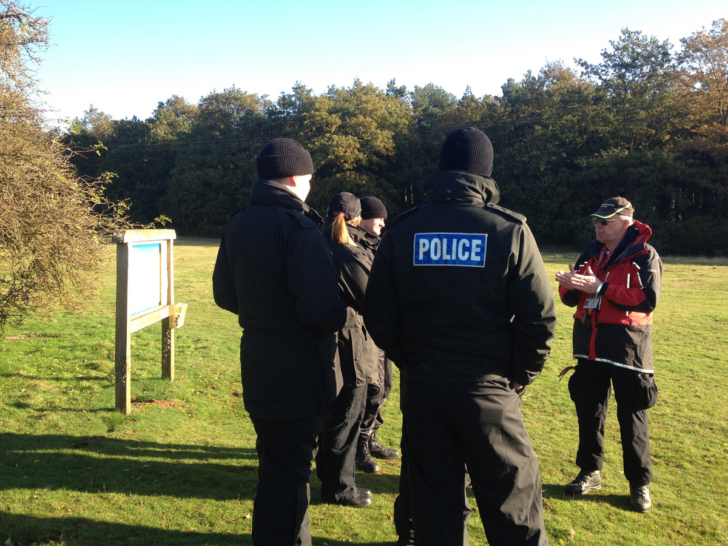

Slide 19


Slide 20
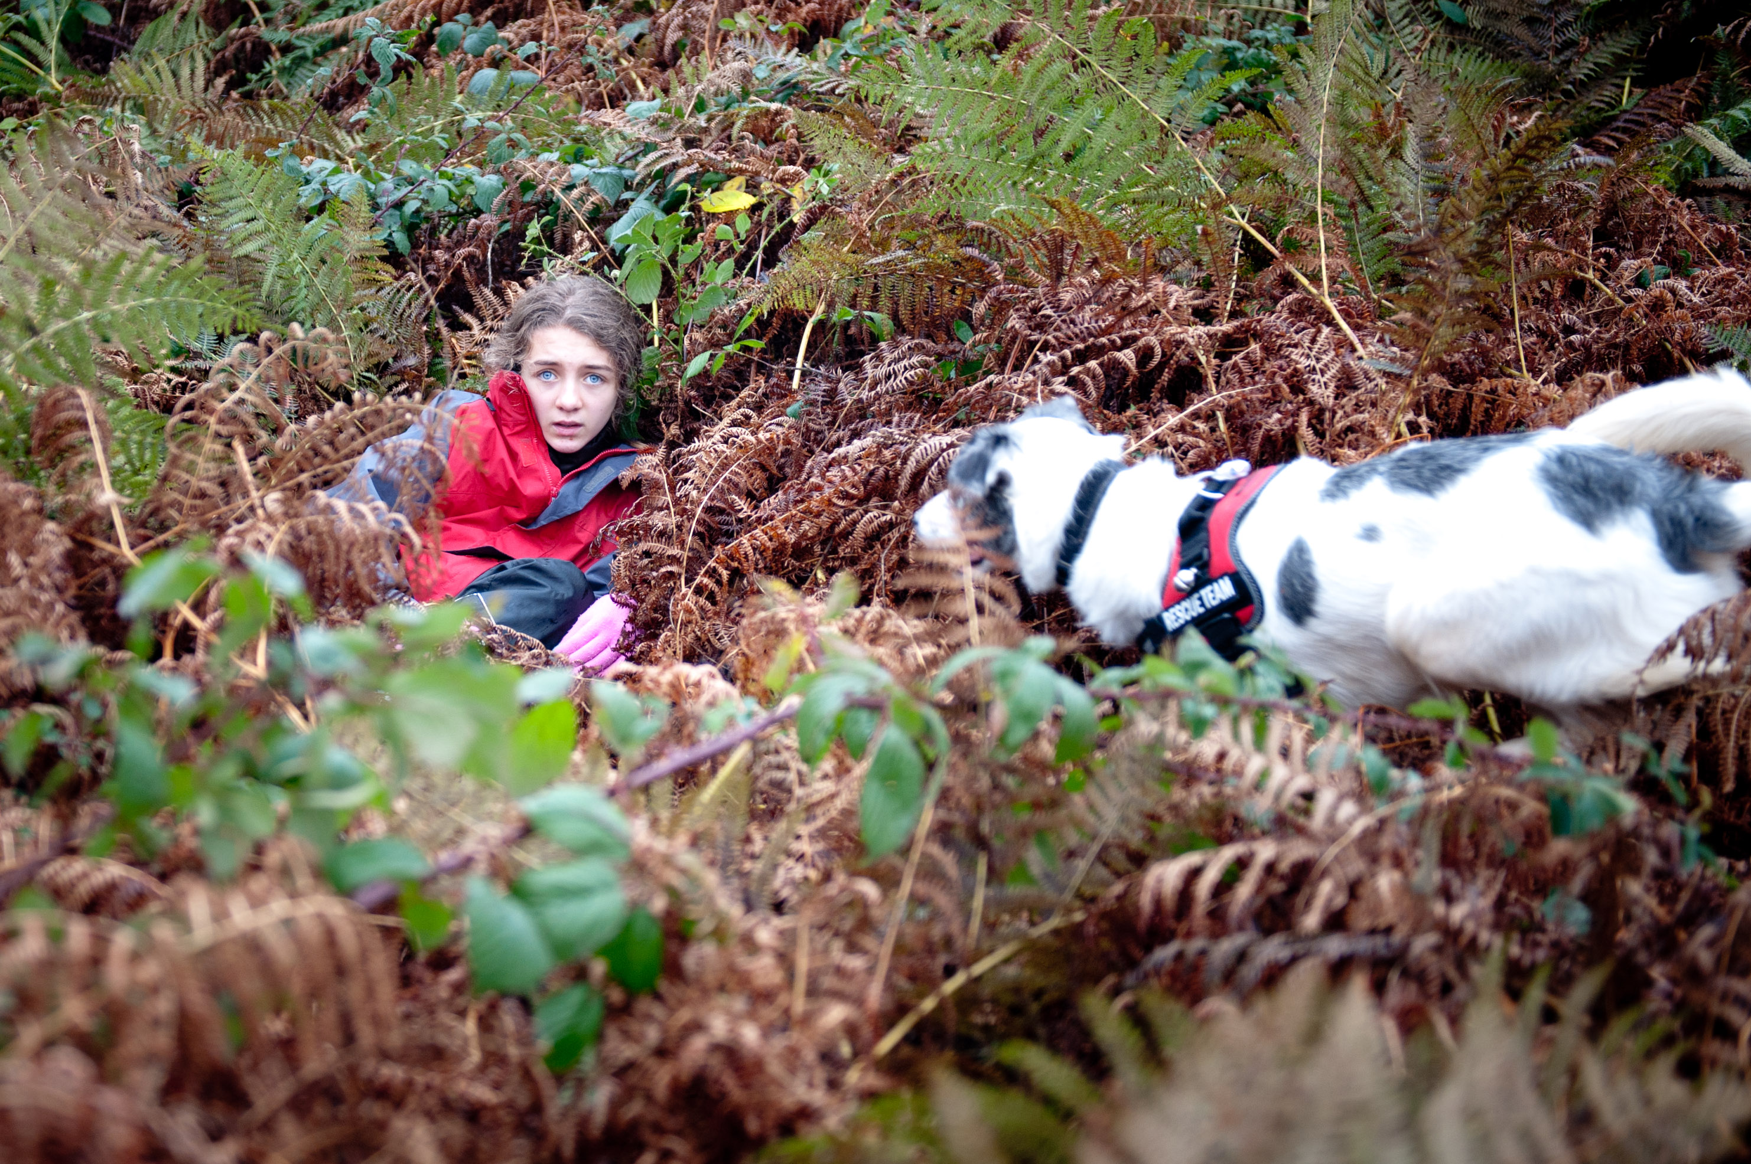

Slide 21
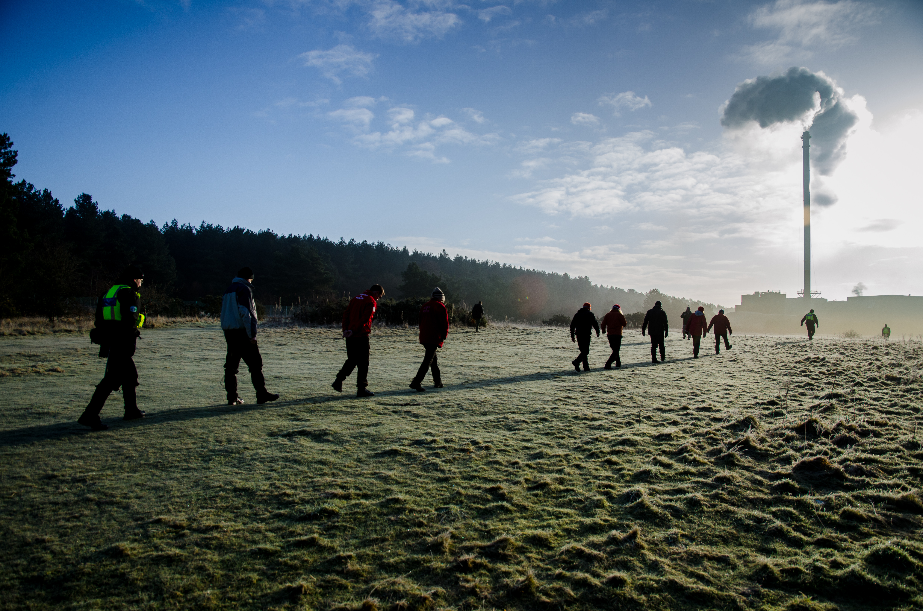

Slide 22
The API story
Your API story continues…

Slide 23
Process?

Slide 24
Recap
Governance key part of Digital Business Platform
Governance Services APIs in RM 2.6
Match core v1 APIs
Cover file plan set up & record ingestion
Docs: http://localhost:8080/gs-api-explorer/
Postman collection: https://github.com/Alfresco/gs-api-postman-collection

Slide 25
Thanks
David.Webster@alfresco.com
@davidcognite
Photos © Lowland Rescue: https://www.flickr.com/photos/lowlandrescue/

